Slide 1

Rockbuster Data Analysis
Prepared by Chris Arnold

Slide 2
Data analysis overview
Utilized tools
SQL – to call up data from within the company database for presentation
EXCEL – to scan and begin analysis of the SQL called data
Tableau – to present meaningful representations of the data to strengthen understanding of the big picture
Goals and Summaries
Present a strategy for Rockbuster to excel in the streaming world and compete with like companies (Netflix, Hulu, Disney Plus, etc)
Show current overall averages for rentals for the films in the company library and the customers in the database
Show regional company metrics and present top performers to give a picture of current company status

Slide 3
Questions leading to the recommended plan Ahead
What are the minimum, maximum, and average values for rental cost, rental length in days, and film replacement cost?
What are the top 10 countries for Rockbuster customers and the cities within those countries that contain the maximum amount of customers?
What are all countries that Rockbuster currently has under service?
What Regions show the highest sales Figures?
What should the per month cost of streaming be?

Slide 4
What are the minimum, maximum, and average values for rental cost, rental length in days, and film replacement cost?
 | Minimum | Average | Maximum
Rental Amount | $0.99 | $2.98 | $4.99
Rental length (in days) | 3 Days | 5 Days | 7 Days
Replacement Cost | $9.99 | $19.98 | $29.99
Total revenue of the company is $61,337.94
Late returns accounted for $18,403.00 of this total which accounts to 30% of overall incoming revenue.
Late fees show across the board in every country and can be accounted for when the total rental cost does not fit the standard fee schedule to the right.
When moving to a streaming platform considerations should be made that late fees would not exist anymore. Thus prices should be set accordingly to take that in to consideration.

Slide 5
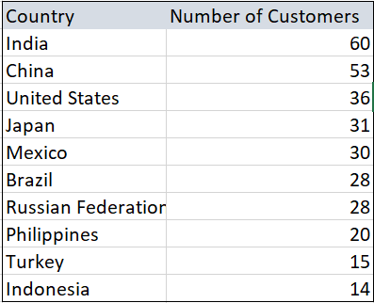
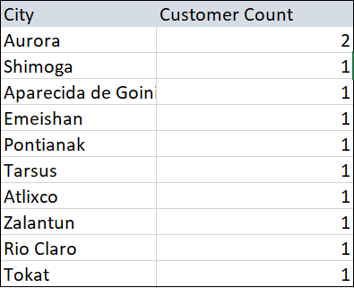
What are the top 10 countries for Rockbuster customers and cities within those countries that contain the maximum amount of customers?
- 2 customers live in the same city from the top 10 customer count cities based on revenue
- The remaining cities on this Top ten list only had one customer within their city limits
- Focus should begin with the high customer count countries as advertising will have an easier time with more word of mouth reinforcement to back it up.

Slide 6
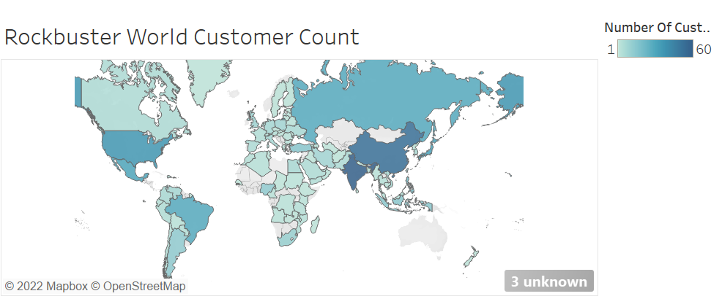
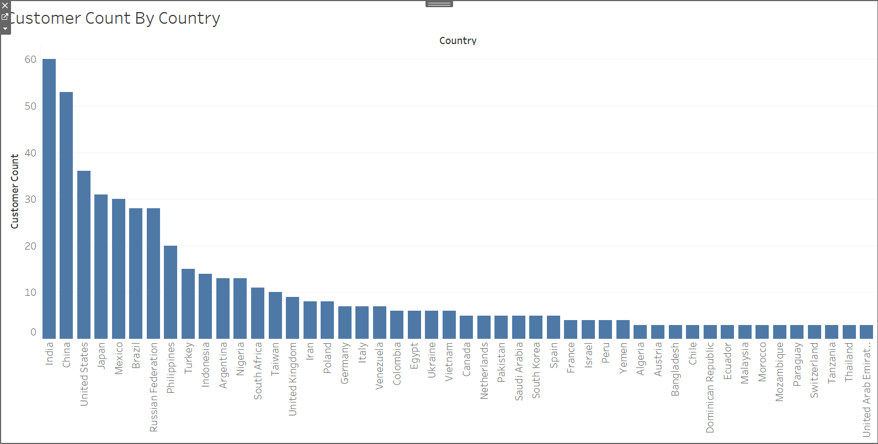
What are all countries that Rockbuster currently has under service?
-Rockbuster currently has 108 countries with costomers
-The highest customer counts come from India (60), China (53), and the Unites States (36) which when taken as a whole make up 24% of the overall Rockbuster revenue.
-The lowest grossing countries also have the lowest customer count (Afghanistan 1, Virgin Islands 1, and Tuvalu 1).
-This further solidifies that countries with the highest customer count should transition to streaming first.

Slide 7
Top 5 customers
Customer Name | City | Country | Total Amount
Sara Perry | Atlixco | Mexico | $128.70
Gabriel Harder | Sivas | Turkey | $108.75
Sergio Stanfield | Celaya | Mexico | $102.76
Clinton Buford | Aurora | United States | $98.76
Adam Gooch | Adoni | India | $97.80
Mexico holds 2 of the top 5 customers within the top 10 countries resided within the same country.
When expanded to the top 10 customers within the top 10 countries we also have 2 within the US, both from Aurora, Colorado.
A great strategy for expansion would be to incentivize top customers to bring on new customers. Offer them free rentals for every customer they refer that ends up renting.

Slide 8

What should the per month cost of streaming be?
Platform | Cost per month
Netflix | $8.99
Hulu | $5.99
Amazon Prime | $8.99
Disney Plus | $7.99
Apple TV | $4.99
Looking at revenue versus customer base, Rockbuster has a total revenue of $661,337.94 and a total of 699 customers.
This gives an average of $87.74 per customer needed to double revenue.
Dividing this by 12 gives $7.32 needed per customer per month to double current revenue within a year with the same customer base.
Charging $7.99 per month falls within other companies shown to the right while leaving some padding for growth (another $5619.96 per year with current customer base).

Slide 9
Ideas to consider in transition to streaming
A tiered approach in the transition to streaming
1) Incentivize customers with free rentals per referral that rents. This would build customer base while streaming platform is developed
2) Release streaming to higher customer count countries first at $7.99 per month.
3) Release streaming to the remaining countries customers once growth is established from tier 2 with incentive that they can take off a dollar per month for 6 months when they bring on a new customer.
Take-aways mentioned so far
When moving to a streaming platform considerations should be made that late fees would not exist anymore. Thus prices should be set accordingly to take that in to consideration.
Focus should begin with the high customer count countries as advertising will have an easier time with more word of mouth reinforcement to back it up, ensuring a stronger transition.
A great strategy for expansion would be to incentivize top customers to bring on new customers. Offer them free rentals for every customer they refer that ends up renting. Offering this to all customers could very quickly double customer base
Charging $7.99 per month falls within other companies shown to the right while leaving some padding for growth (another $5619.96 per year with current customer base).

Slide 10

Thank you for you time today
Link to visualizations https://public.tableau.com/app/profile/chris.charles.arnold/viz/Rockbustercustomercounts/Dashboard1
Link to competitor streaming pricing: https://www.usnews.com/360-reviews/technology/streaming-services
Email for questions: Arnold.chris50@yahoo.com

